Slide 1

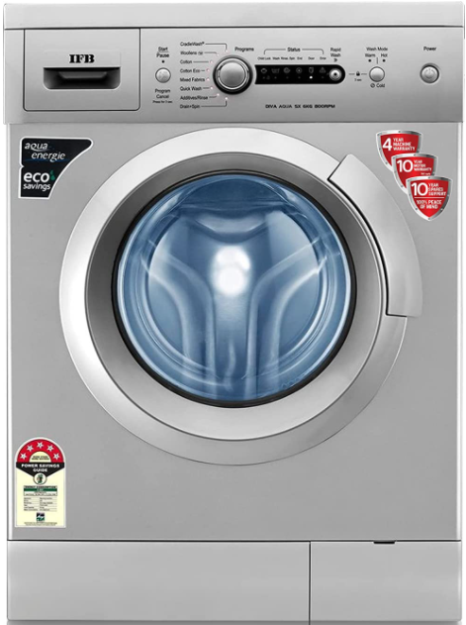
Business Problem:
Review Analysis of IFB washing Machine
Objective:
Most of the people are expressing their view by posting it on social platforms about a product. We need to understand the liking or disliking of that product to help the organization to make some decisions about the production and supply of the same in the market. So here consider extracting reviews from ecommerce websites and analyze them to satisfy the objective

Slide 2
Project on
Review Analysis of IFB washing Machine
By
Group No. 6
Manichandana Jillepalli Prateek Singh
Pratik Khedkar Deeban VM
Vishal Ingle Karthik Ongoji
Pradeep Khaire
Date :- 13/01/2020

Slide 3
Project Architecture / Project Flow
Selecting the product according to problem statement
Scraping the reviews and ratings of product from the Amazon
EDA –
Cleaning of the review text
Sentiment from ratings
Checking for balance of positive and negative reviews
Creating Bag of words with CountVectorizer
Checking for most frequent words in positive and negative reviews
Train test split
Fitting models
Evaluating models
Selecting final model depending on accuracy metrics
Final Model Fitting
Deployment on Suitable Platform

Slide 4
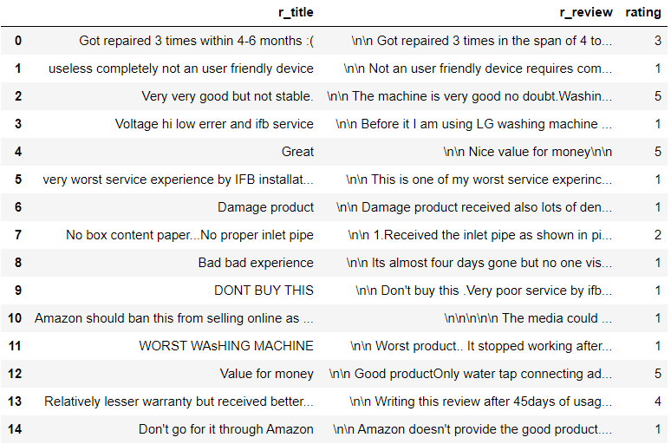
Data set details
Total Records:- (1050,3)
Missing values:- 5
Duplicate values :- 0

Slide 5
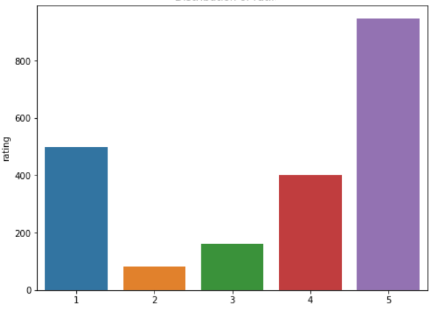
Exploratory Data Analysis (EDA) & Feature Engineering
Distribution of ratings

Slide 6
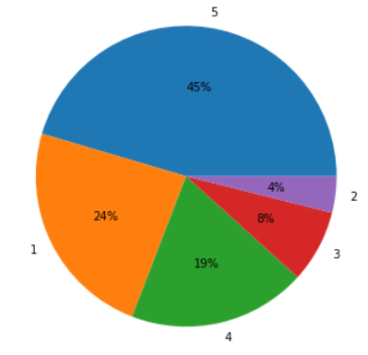
Exploratory Data Analysis (EDA) & Feature Engineering
Distribution of ratings

Slide 7
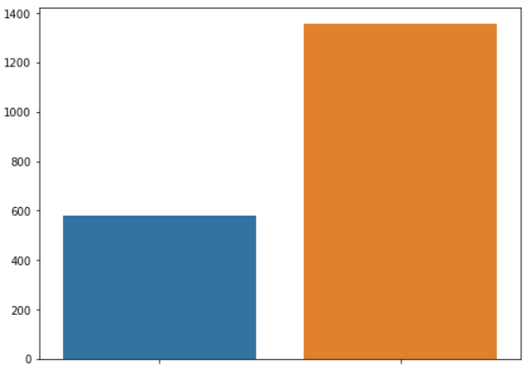
Exploratory Data Analysis (EDA) & Feature Engineering
Mapping of Reviews in Positive and Negative:-
Considering 1 & 2 rating as negative review
Considering 4 & 5 rating as positive review
No. of Positive :-1356
No. of Negative :- 580
Count
Negative
Positive

Slide 8
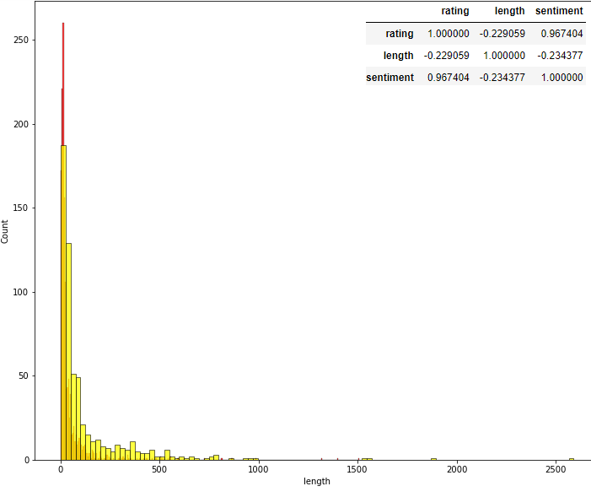
Exploratory Data Analysis (EDA) & Feature Engineering
Checking if length of review has any correlation with positive and negative sentiment
From graph, we can see that there is no as such correlation between length of review and sentiment

Slide 9

EDA- Common words in Positive Reviews

Slide 10

EDA- Common words in Negative Reviews

Slide 11
Model Building
Following models were tried for this project
Bernoulli Naïve Bayes
Gaussian Naïve Bayes
Multinomial Naïve Bayes
Random Forest Classifier
Support Vector Machines
Logistic Regression
Extra Trees Classifier
Ada Boost Classifier
Gradient Boosting Classifier
Voting Classifier

Slide 12
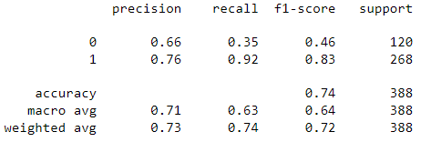
Bernoulli Naïve Bayes
Algorithm details and configuration:-
BernoulliNB (alpha=1.0, binarize=0.0, fit_prior=True)
Data set details:- (1936, 2)
Data Partition details:-
80 % Data used for training 20 % Data used for testing

Slide 13
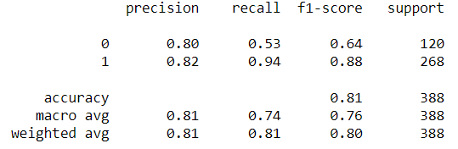
Gaussian Naïve Bayes
Data set details:- (1936, 2)
Algorithm details and configuration:-
GaussianNB( priors=None, var_smoothing=1e-09))
Data Partition details:-
80 % Data used for training 20 % Data used for testing

Slide 14
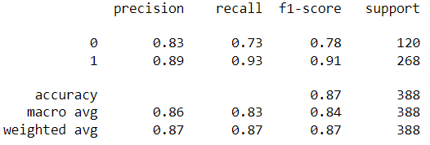
Multinomial Naïve Bayes
Data set details:- (1936, 2)
Algorithm details and configuration:-
MultinomialNB(alpha=1.0, fit_prior=True)
Data Partition details:-
80 % Data used for training 20 % Data used for testing

Slide 15
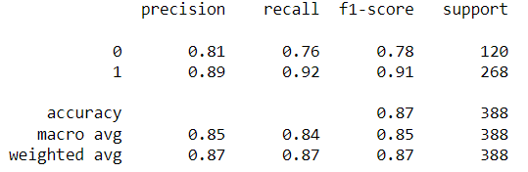
Random Forest Classifier
Data set details:- (1936, 2)
Algorithm details and configuration:-
RandomForestClassifier(n_estimators=500, random_state=42)
Data Partition details:-
80 % Data used for training 20 % Data used for testing

Slide 16
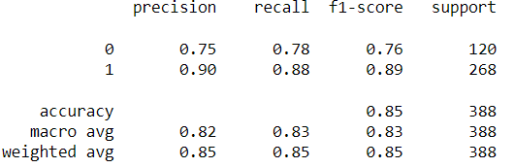
Support Vector Machines
Data set details:- (1936, 2)
Algorithm details and configuration:-
SVC(C=10, kernel= 'rbf‘ )
Data Partition details:-
80 % Data used for training 20 % Data used for testing

Slide 17
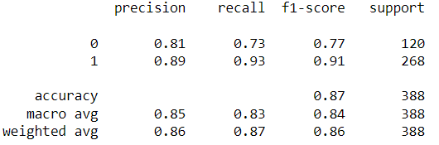
Logistic Regression
Data set details:- (1936, 2)
Algorithm details and configuration:-
LogisticRegression (solver ='lbfgs',
multi_class ='multinomial',
max_iter = 200)
Data Partition details:-
80 % Data used for training 20 % Data used for testing

Slide 18
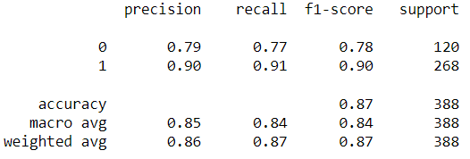
Ada-Boost Classifier
Data set details:- (1936, 2)
Algorithm details and configuration:-
AdaBoostClassifier(n_estimators=500 , random_state=42)
Data Partition details:-
80 % Data used for training 20 % Data used for testing

Slide 19
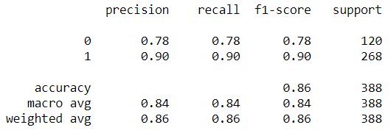
Extra Trees Classifier
Data set details:- (1936, 2)
Algorithm details and configuration:-
ExtraTreesClassifier(n_estimators=500)
Data Partition details:-
80 % Data used for training 20 % Data used for testing

Slide 20
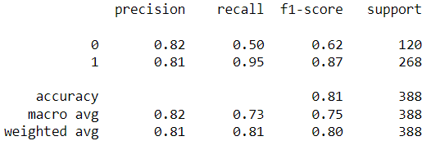
Gradient Boosting Classifier
Data set details:- (1936, 2)
Algorithm details and configuration:-
GradientBoostingClassifier(n_estimators=500, random_state=42,learning_rate=0.01)
Data Partition details:-
80 % Data used for training 20 % Data used for testing

Slide 21
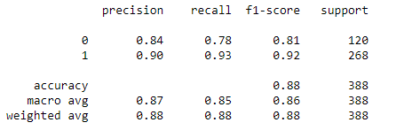
Voting Classifier
Data set details:- (1936, 2)
Data Partition details:-
80 % Data used for training 20 % Data used for testing
estimator = []
estimator.append(('LR', LogisticRegression(solver ='lbfgs', multi_class ='multinomial', max_iter = 200)))
estimator.append(('etc', ExtraTreesClassifier(n_estimators=500)))
estimator.append(('rf',RandomForestClassifier(n_estimators=500, random_state=42) ))
estimator.append(('mnb',MultinomialNB() ))
VotingClassifier(estimators = estimator, voting ='hard')

Slide 22
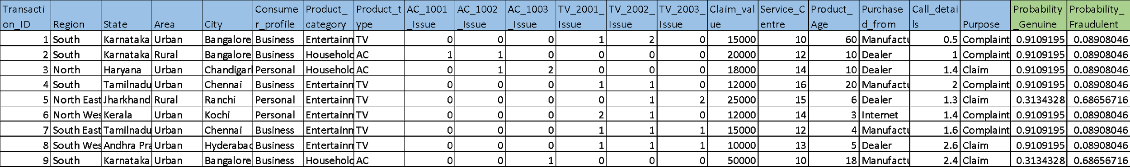
Model Predictions
Predicted probabilities for each transaction
Example
Transaction data fed to the model

Slide 23
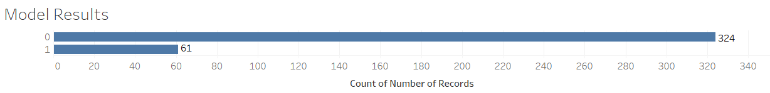
Model Results
Example
Model generated the output for the transaction data set in which 324 transactions are genuine(0) claims and 61 transaction are fraudulent(1)

Slide 24
Model Deployment using R shiny / Flask or any other method

Slide 25
Challenges faced?
How did you overcome?

Slide 26
Thank you

